Slide 1

Adina malik asif

Slide 2
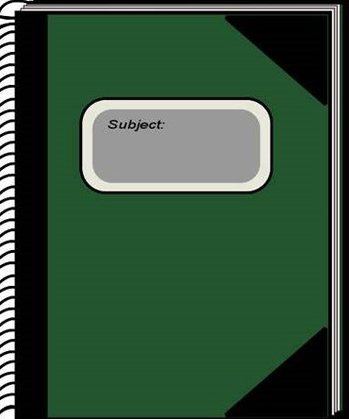
ABOUT ME
Hi! My name is Adina Malik Asif. I am 20 years old and from Islamabad. I am a student at IBA Karachi, studying the BBA Program.

Slide 3
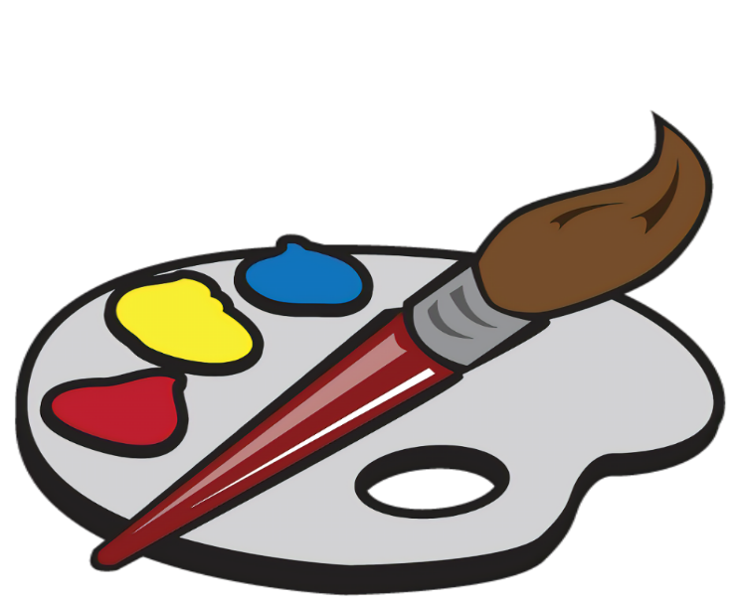

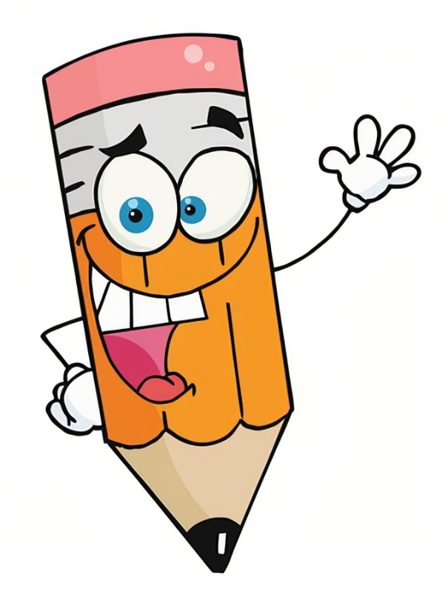
My skills
I enjoy doing art. I am pretty good at sketching, painting, and doodling.

Slide 4
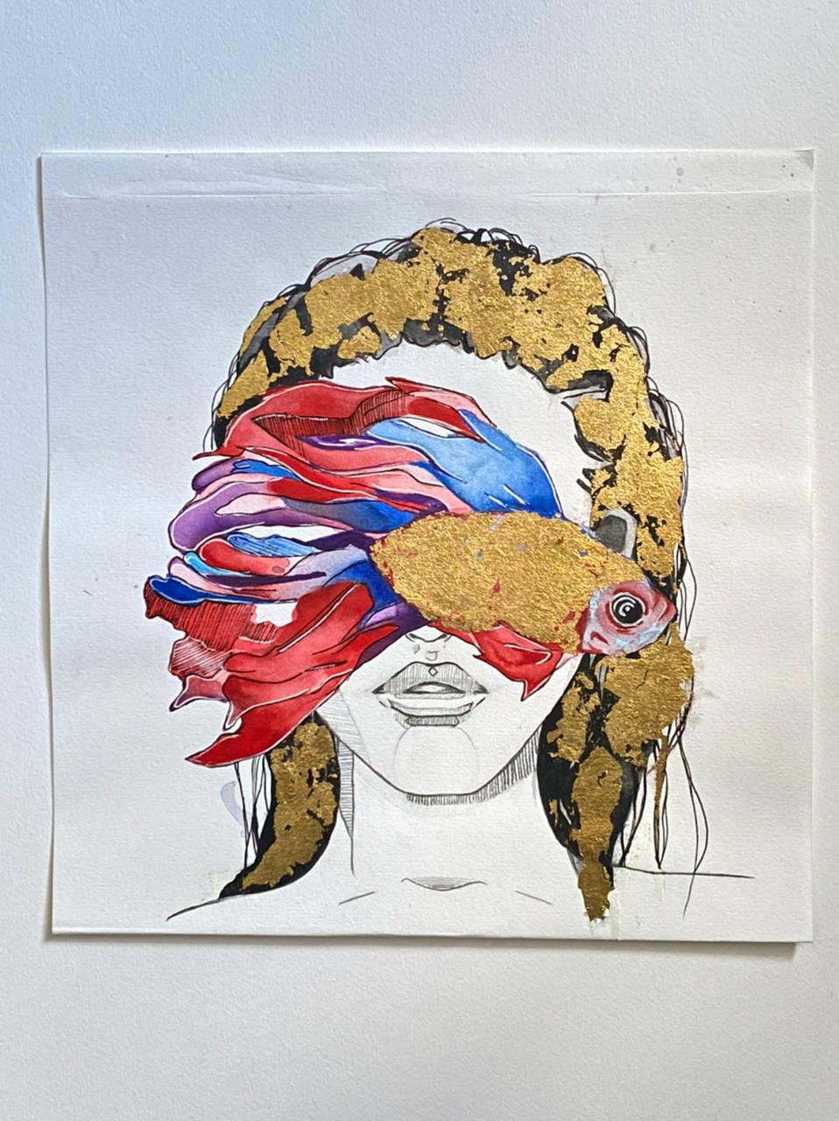
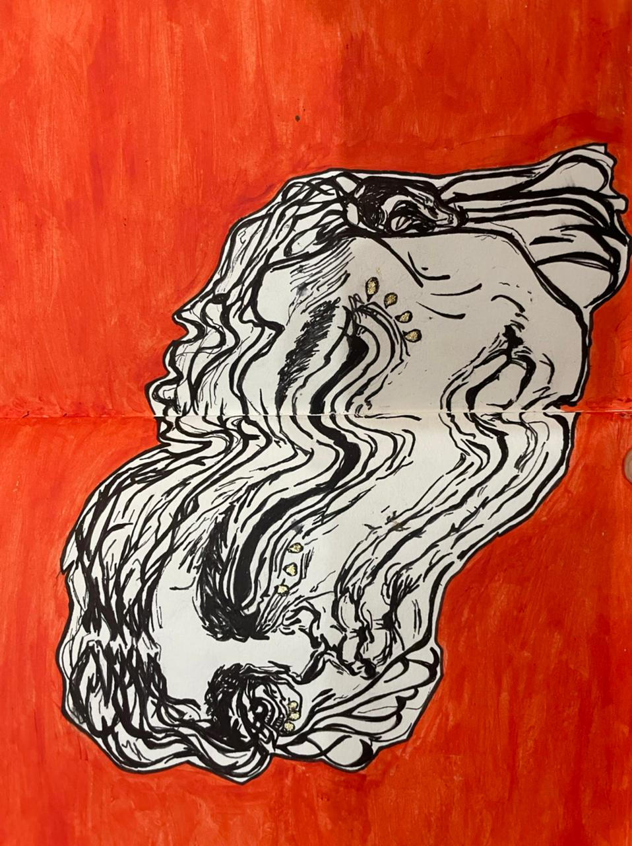
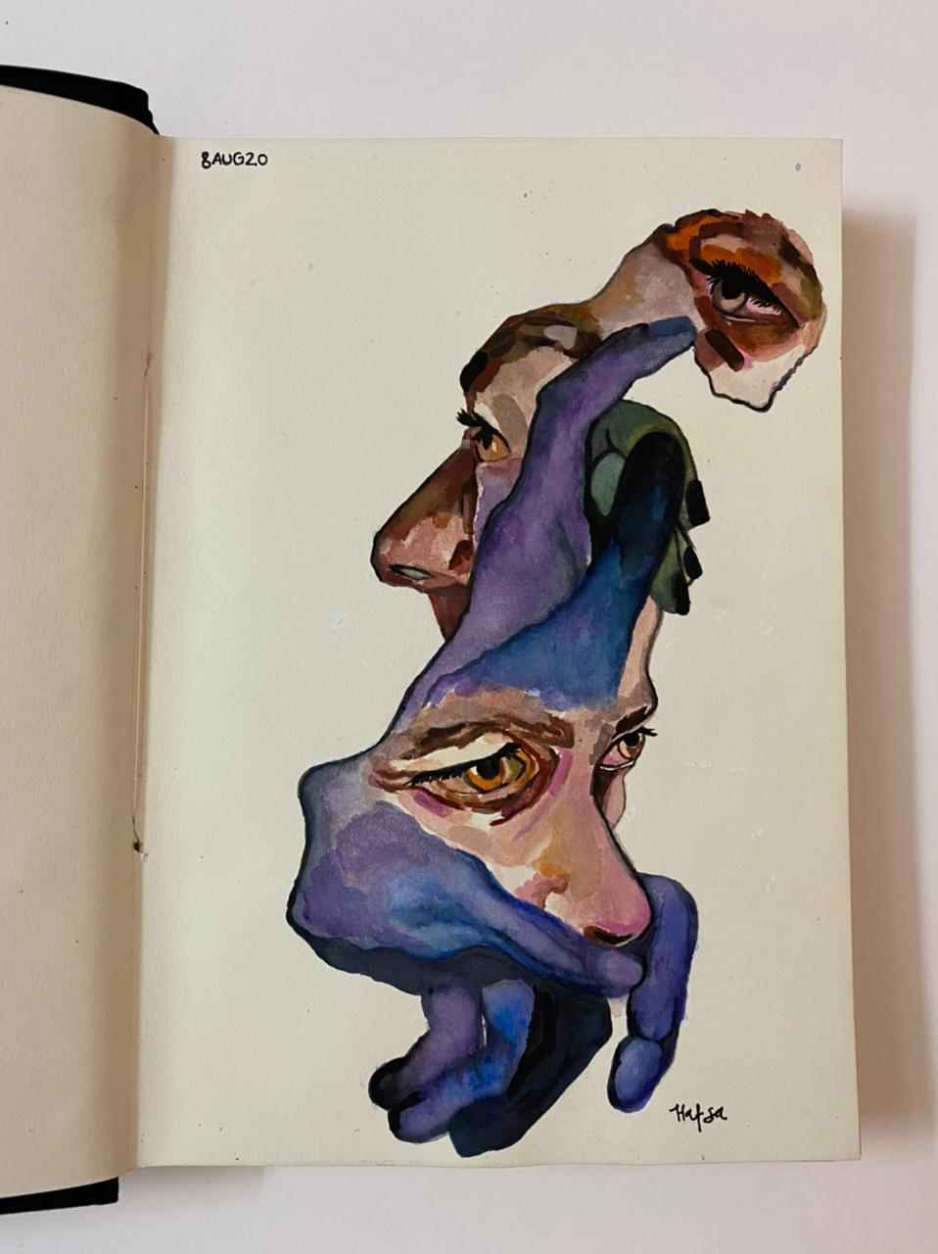
Here are some of my paintings.

Slide 5
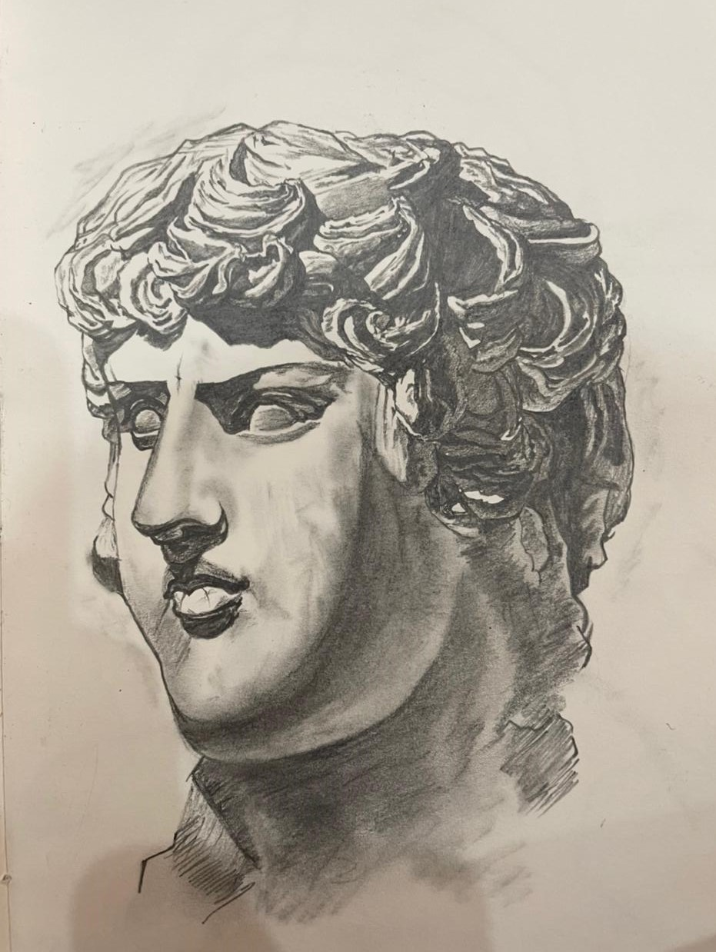
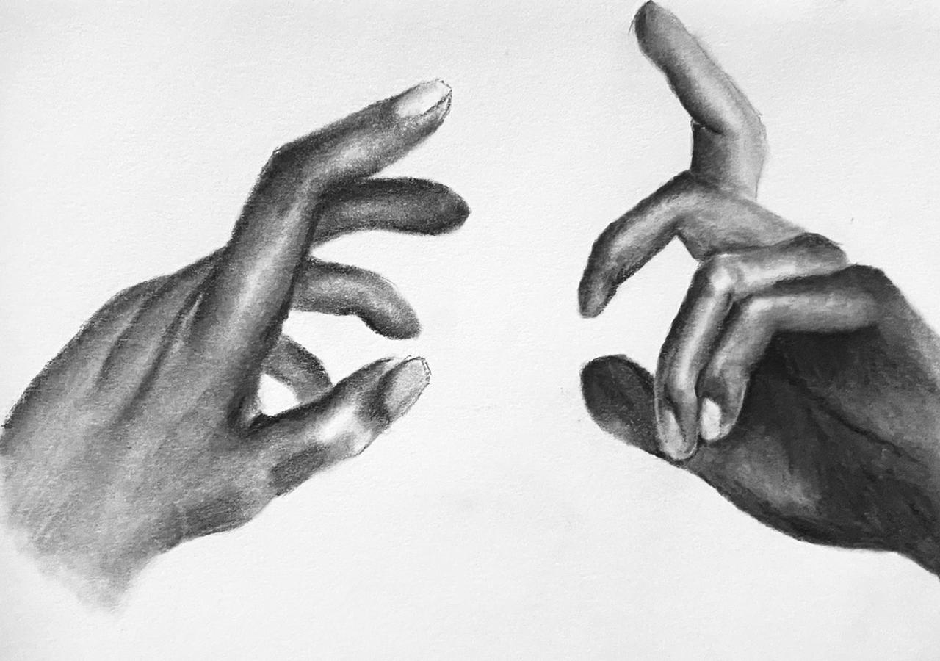
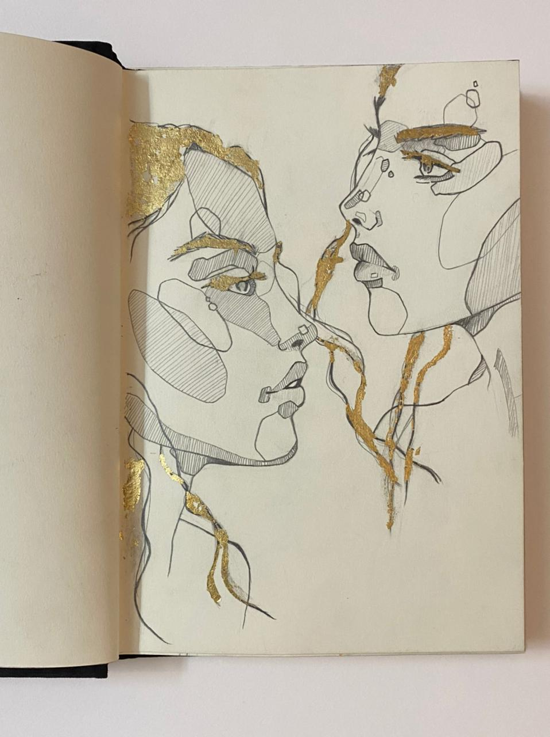
These are some of my sketches.

Slide 6

EDUCATION
I received my primary education in Quetta, Pakistan.
I moved to Karachi in 2010 and did my O levels with a medical background, as a private candidate.
In 2019, I moved to Islamabad with my family and completed my A levels with the same subjects as O levels.
I am currently studying BBA at IBA Karachi.

Slide 7


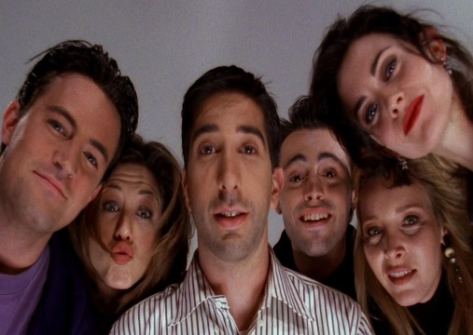

MY HOBBIES
Reading
Listening to music
Watching TV Shows
Drawing

Slide 8
Some random things I love:
Tea.
Beaches.
Quality time with my family and friends.
Urdu poetry.
10 hours of sleep everyday.
Sunsets.
Desi street food.
Snowfall.
Iced Coffee.

Slide 9
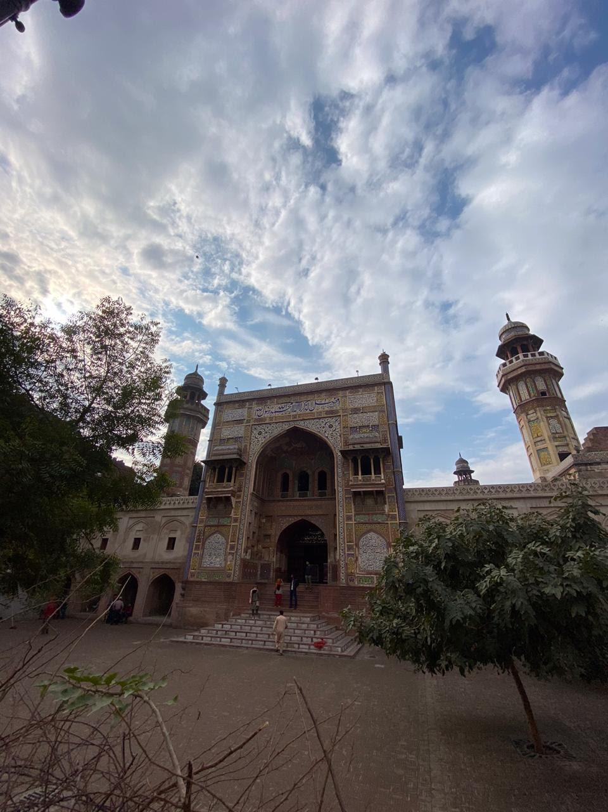
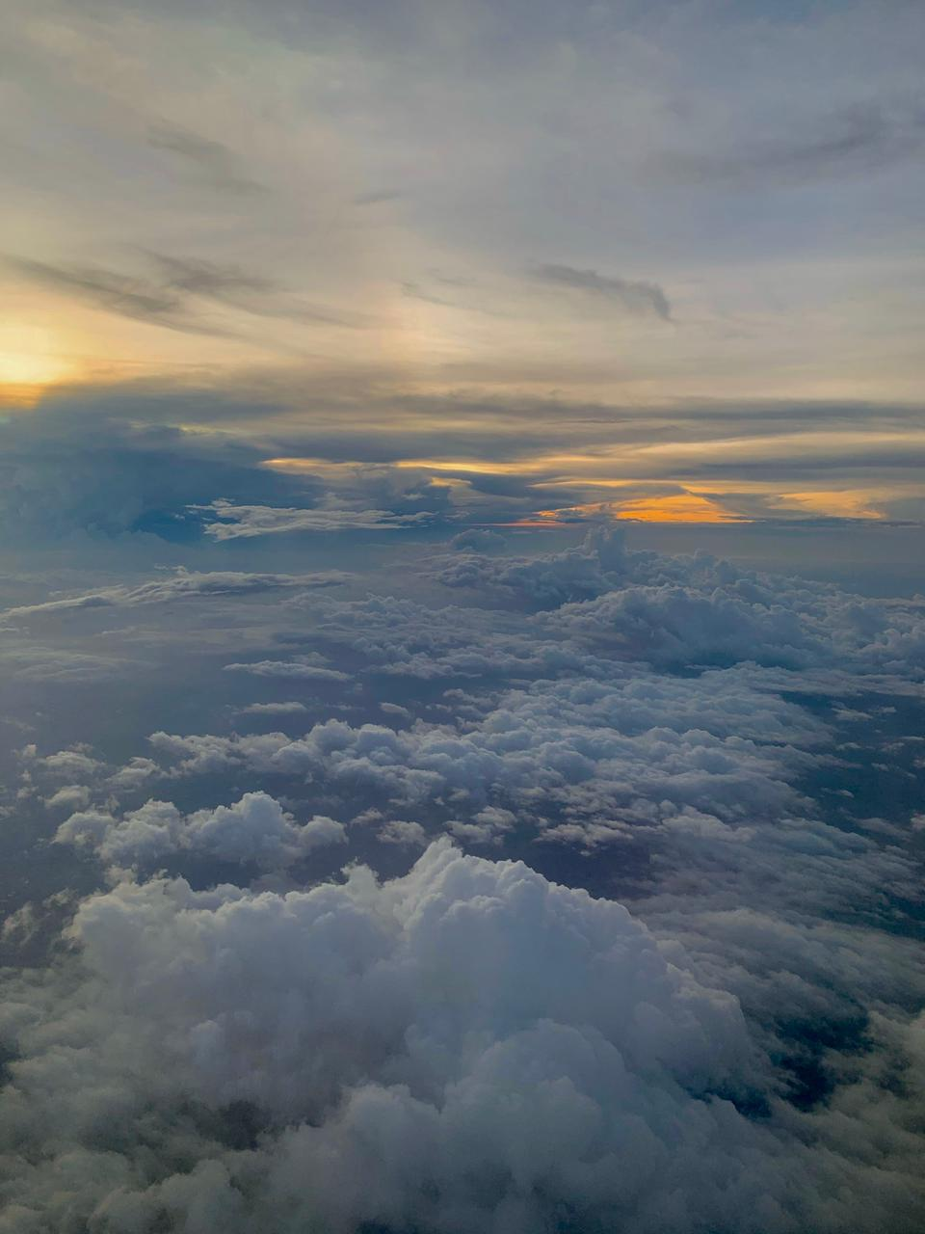
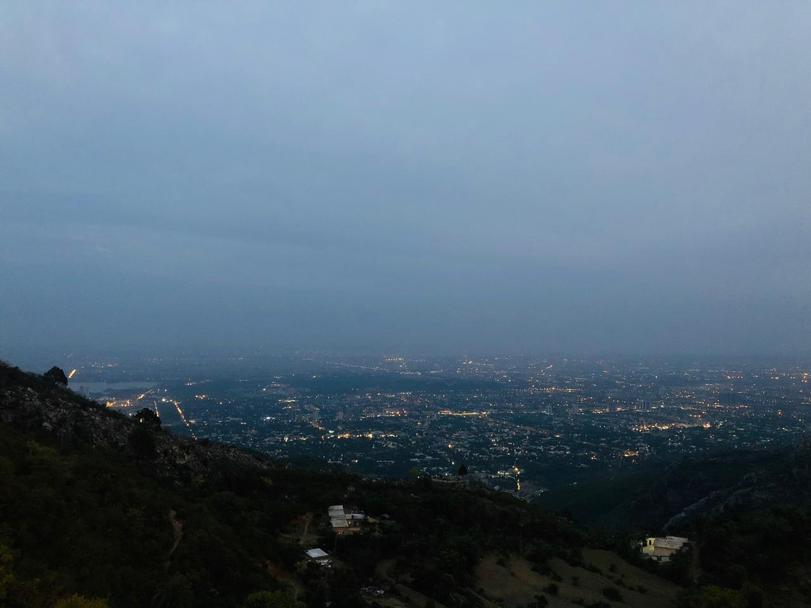
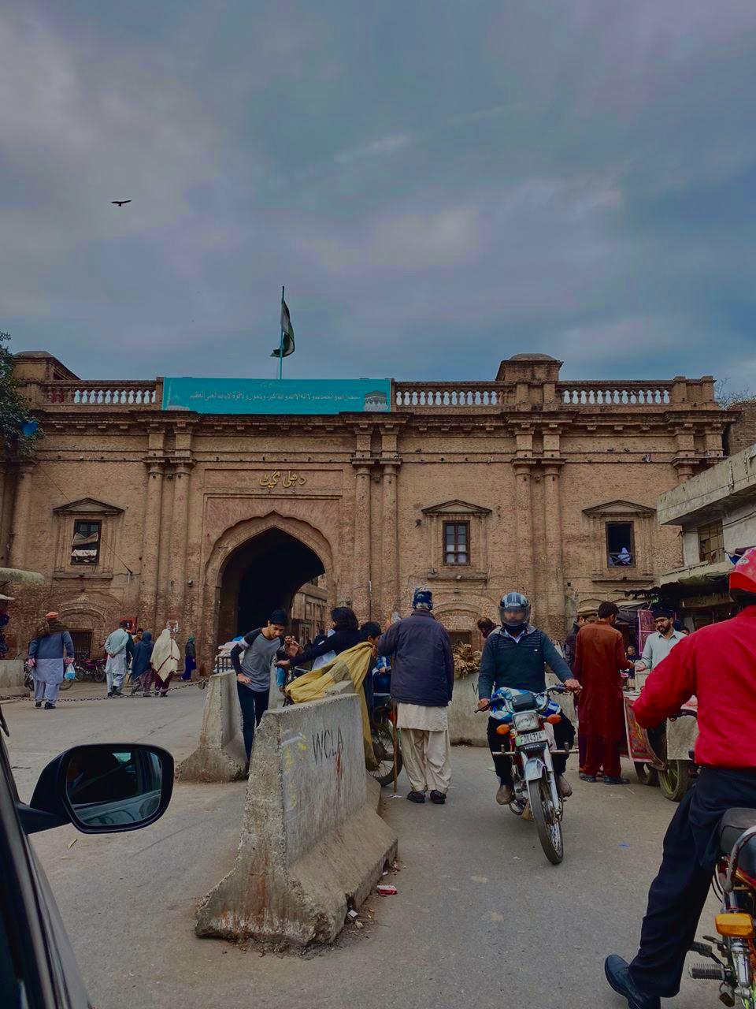
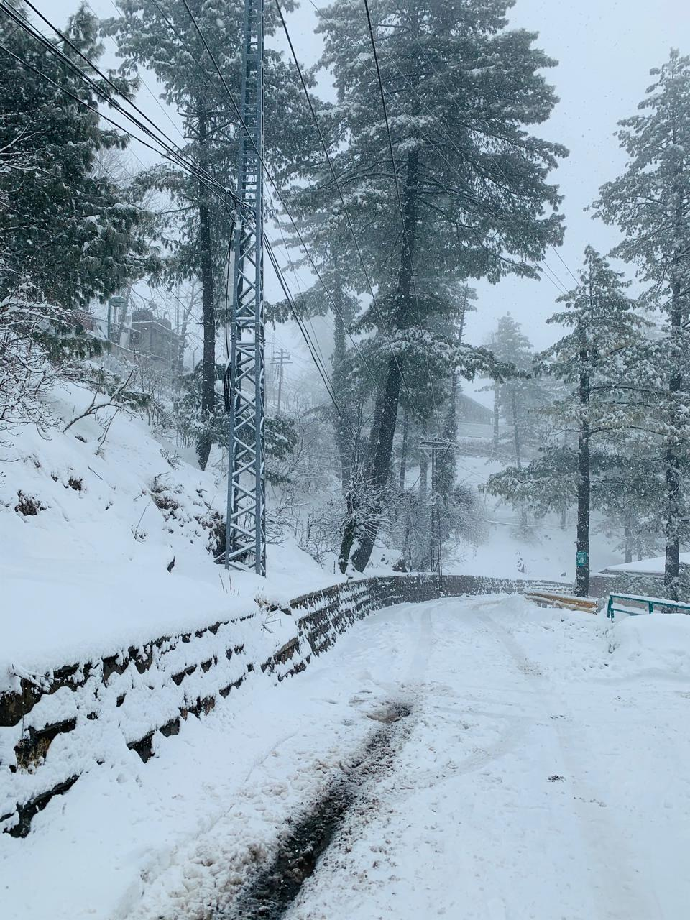
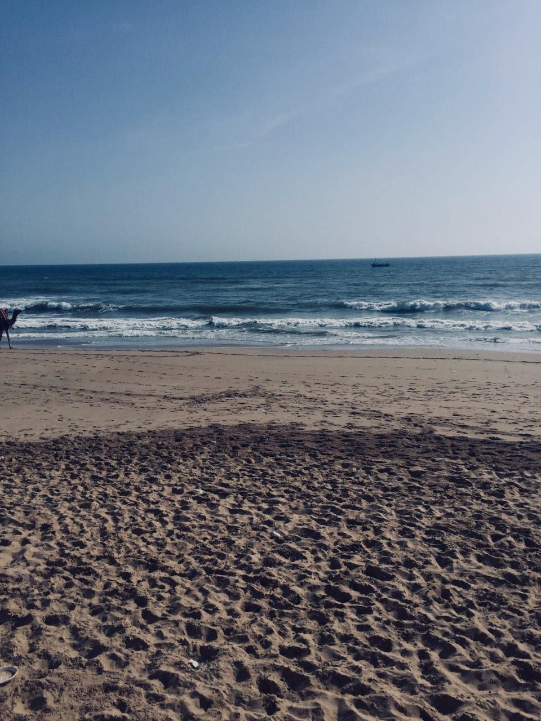
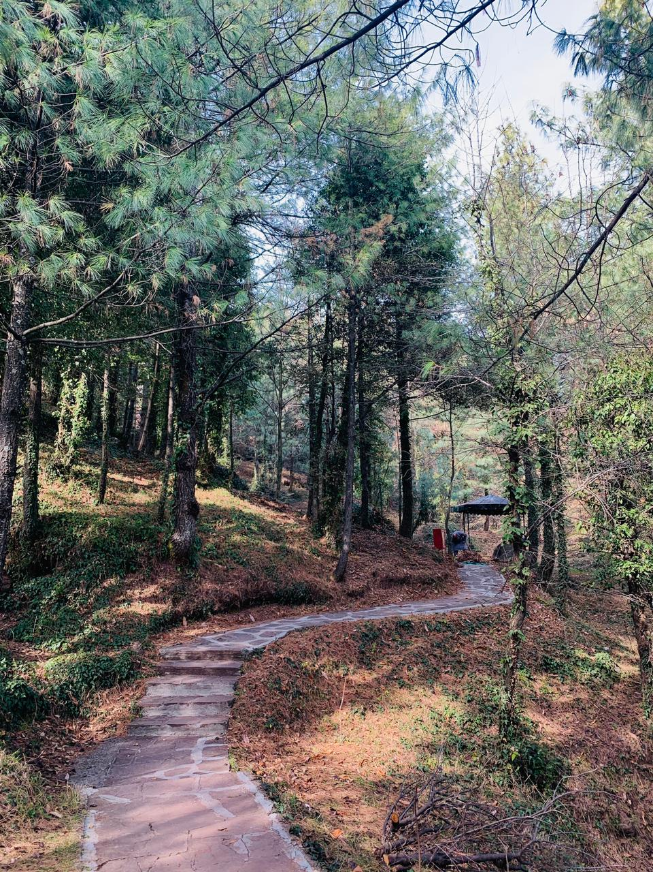
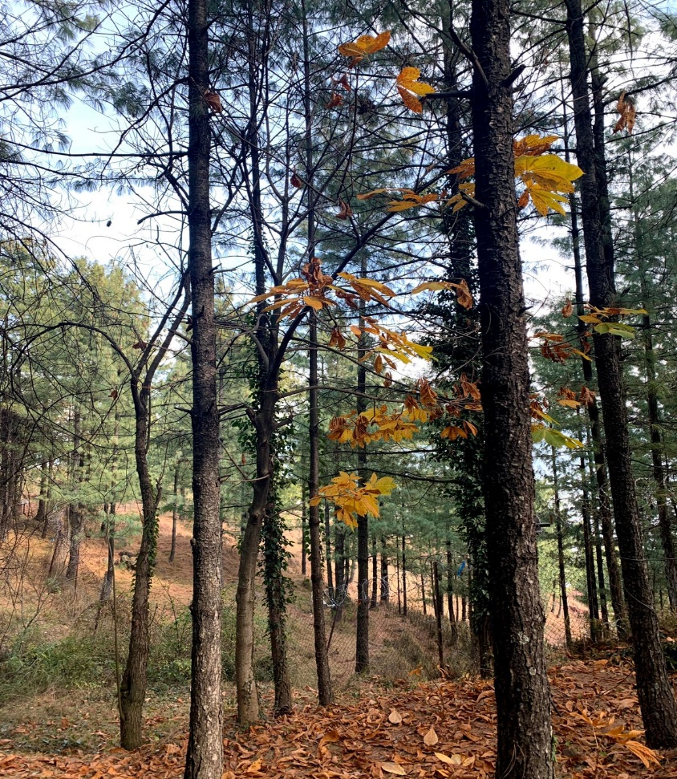
I also love taking pictures and here are some I took.

Slide 10

It was nice introducing myself to you all!
Take care, good bye (:

